Slide 1



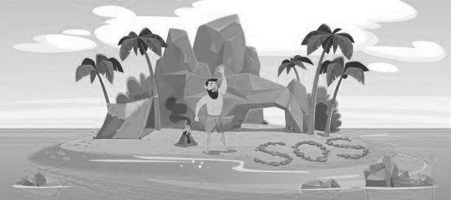
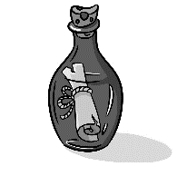



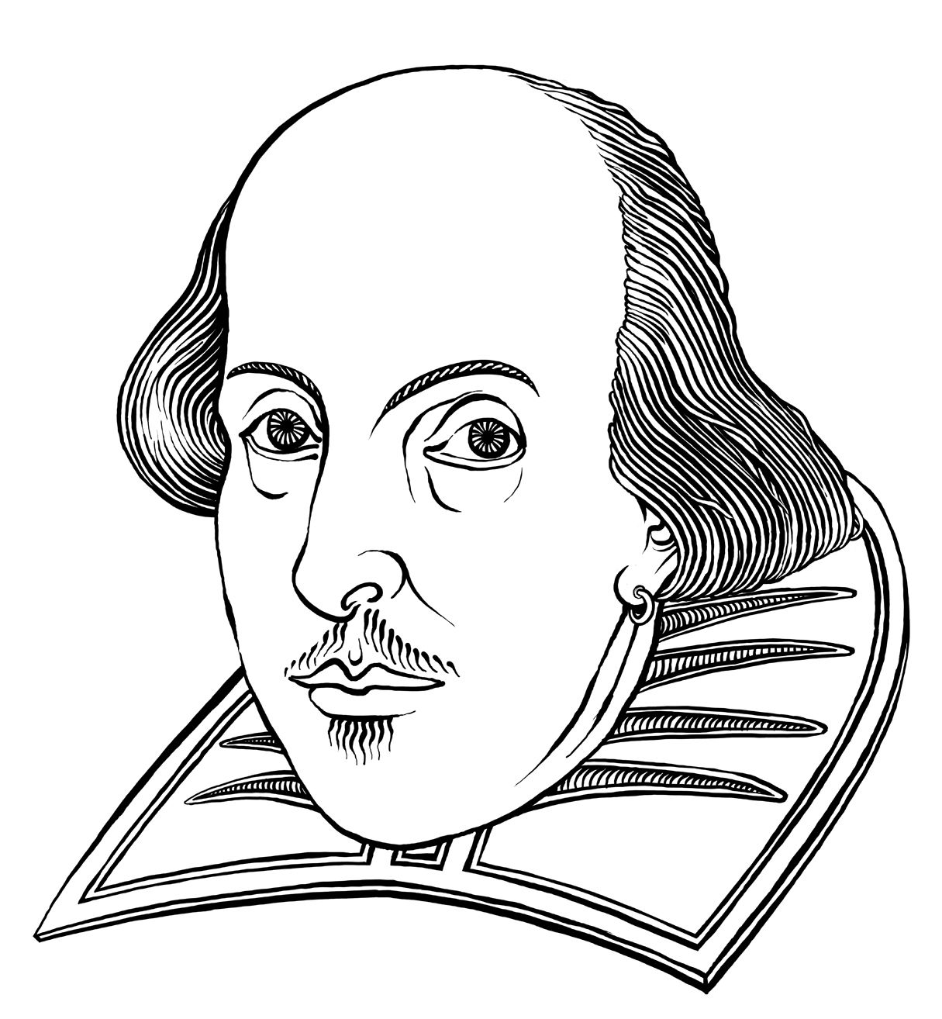


Accurate use of SPAG
Read for meaning
Develop oracy skills
YEAR 8 ENGLISH AT
End of Yr7
Understanding and applying literacy skills
End of KS3
Move up to year
9/10
Use vocabulary for effect
Write for a range of purposes, audience and text types
Analyse language and structure
Reading and writing assessment
LIFE SKILLS (Class 5) PATHWAY
Summer
2
The Island and Cultural Poetry
Writing Assessment
The Island and Cultural Poetry
Spring
2
Summer
1
Writing assessment
Macbeth and Fantasy Writing
Spoken Language and Reading assessment
Spring
1
Macbeth and
Fantasy Writing
The Boy at the Back of the Class by Onjali Q. Raúf
Reading assessment
Autumn
1
Autumn
2
The Boy at the Back of the Class by Onjali Q. Raúf
Writing assessment
Baseline Assessment

