Slide 1



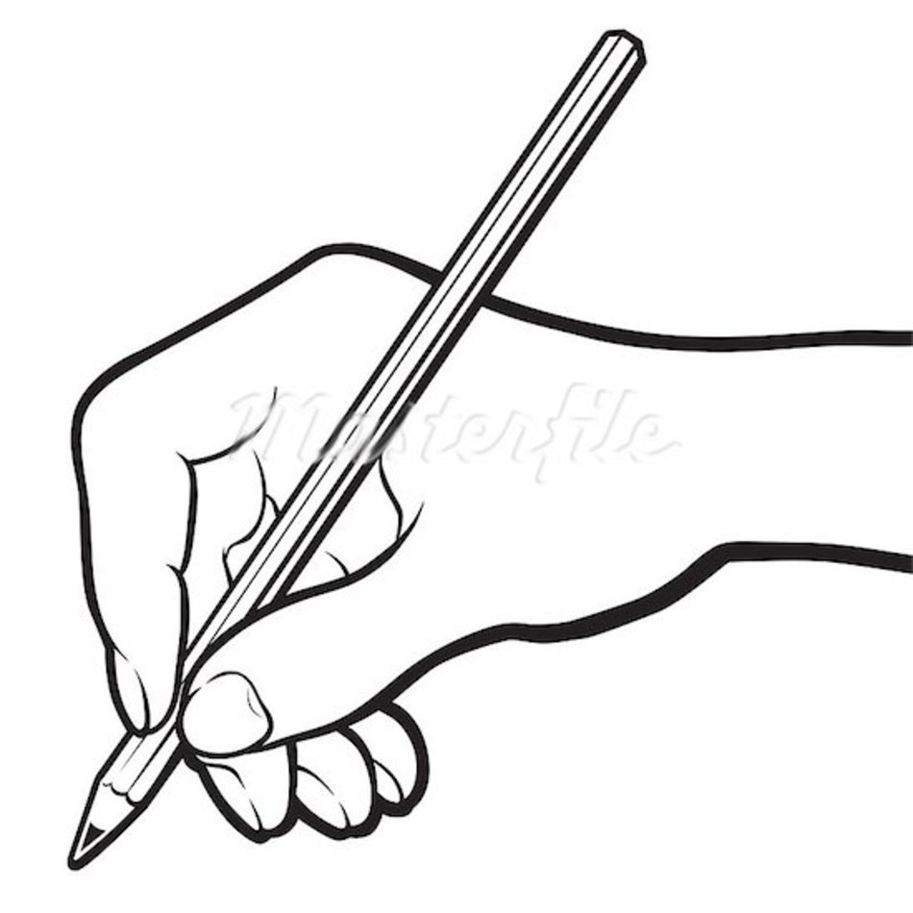






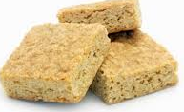


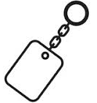


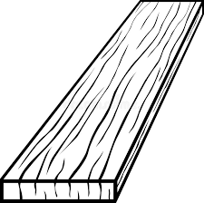

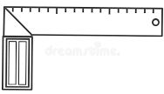



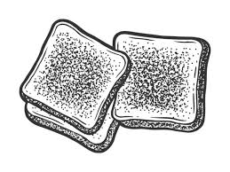
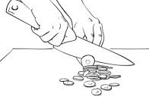



Use specialist tools, machines and techniques
Use a range of materials, components and ingredients
Cook and apply the principles of nutrition and healthy eating.
YEAR 7 Technology in
Use research to identify user needs
Develop specifications
Year 7
Year 8
Solve design problems
Develop design ideas
Analyse work of professionals
Develop technical knowledge
Test, evaluate and refine ideas
2D design
D&T Evaluation
End of unit Assessment
CAD Milling
Summer
2
CORE PATHWAY
D&T –Design development
Electronics
D&T –Research, design brief, Specification.
D&T – Nightlight project/ electronics CAD/CAM
End of unit Assessment
FT - Meat
Drilling and shaping
FT - Sausage Rolls
FT -Eggs
FT - Breakfast muffins
FT - Milk
Spring
2
Summer
1
Eggy bread
FT – Dairy foods
FT - Flapjacks
FT- Fruits & vegetables
FT - Apple crumble
End of unit Assessment
End of unit Assessment
D&T – Keyring project/ 2D design CAD/CAM
D&T - 2D Design
Spring
1
D&T - Acrylic
Ft - Starchy carbohydrates
D&T - Marking out onto wood
D&T -Pencil holder project
FT - Using the hob / conduction
Baseline Assessment
D&T Construction
D&T –Design development
D&T - Timber
Autumn
1
Energy stores and transfers
D&T Evaluation
D&T Planning
D&T –Research, design brief, Specification.
Autumn
2
End of unit Assessment
DT – Health & safety in the work shop
FT- Hygiene and safety
FT – Toasting/ Dextrinisation
FT - Knife safety / enzymic browning
FT - Using the oven / convection
FT - Eatwell Guide
Weighing/measuring

Slide 2

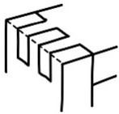
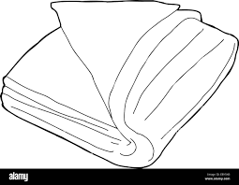

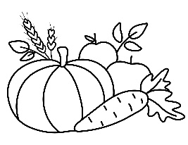

D&T –Design development
Use specialist tools, machines and techniques
Use a range of materials, components and ingredients
Cook and apply the principles of nutrition and healthy eating.
YEAR 8 TECHNOLOGY IN
Use research to identify user needs
Develop specifications
Year 8
Year 9
Year 9
Solve design problems
Develop design ideas
Analyse work of professionals
Develop technical knowledge
Test, evaluate and refine ideas
D&T Evaluation
Year 8 LIFE SKILLS PATHWAY
Summer
2
D&T – Construction
Assessment
D&T –Research, design brief, Specification.
Wood joints
Box Project
End of unit Assessment
FT - Sausage Rolls
FT -Eggs
FT - Breakfast muffins
FT - Milk
Summer
1
Natural / manufactured timber
FT - Meat
D&T Types of stitching
D&T Fabrics and decoration
FT – Dairy foods
D&T –Research, design brief, Specification.
D&T –Design development
D&T – Template Making
D&T Evaluation
Assessment
Spring
2
D&T Planning
D&T Construction
Spring
1
D&T -Textiles Cushion Project
FT - Using the hob / conduction
D&T Construction
D&T –Design development
D&T - Marking out onto wood
Assessment
5 a day
FT - Flapjacks
Assessment
Autumn
1
D&T Evaluation
Autumn
2
D&T –Research, design brief, Specification.
D&T -Pencil holder project
FT- Hygiene and safety
FT – Toasting/ Dextrinisation
FT - Knife safety / enzymic browning
FT - Using the oven / convection
DT – Health & safety in the work shop
FT - Eatwell Guide
Weighing/measuring
Baseline Assessment

