Slide 1




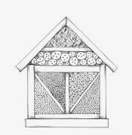








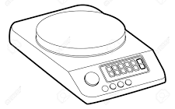
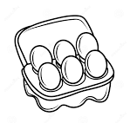
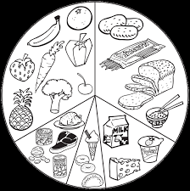

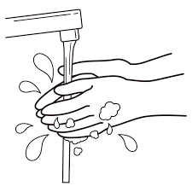
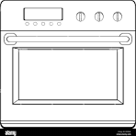





CORLEY ACADEMY TECHNOLOGY CURRICULUM JOURNEY
LIFE SKILLS PATHWAY
ASDAN L1
Design purchase and install a basic garden and seating area.
Flower arrangements
Kitchen hygiene
Use household products to clean the home safely
Planning a journey
ASDAN EL3
Gardening activities
Doing my own laundry
Using an iron
Going shopping on a budget
Upcycle small items
Building an item of IKEA furniture
End of KS4
KS4
Life skills challenges support the application of skills and knowledge taught during KS3
ASDAN EL2
Storing food safely
Recycle clothing
Use the google calendar app
FT – Multicultural foods
FT – Special diets
FT – Food packaging
D&T– Minibeast hotel
D&T – Mechanisms
FT -Eatwell Guide and energy
D&T – Textiles Patchwork quilt
9
KS3 Curriculum
D&T –
Box Project
FT - Starchy carbohydrates / Rubbing In
D&T – Textiles cushion project
FT - Fruits and vegetables
FT - Peeling and chopping
FT – Dairy Foods, Eggs and meat
FT –Using the hob
Weighing & measuring
D&T–Wooden Pencil holder project
8
FT - The Eatwell Guide
FT -Sensory testing
and evaluation
KS3 Curriculum
FT- Health and Hygiene
FT -Food Preparation
FT – Using the oven.
D&T – Health and Safety.
FT – The Great Corley Bake Off
D&T – Textiles printing and embellishments
D&T – Textiles money pouch project
Baseline Assessment
KS3 Curriculum
7
D&T – Mechanisms
Woodwork skills
Christmas Tree competition
Use research to identify user needs
Develop specifications
Use specialist tools, machines and techniques
Use a range of materials, components and ingredients
Cook and apply the principles of nutrition and healthy eating.
Year 7
Designing and making skills / Technical knowledge
Year 11
Solve design problems
Develop design ideas
Analyse work of professionals
Develop technical knowledge
Test, evaluate and refine ideas

