Slide 1




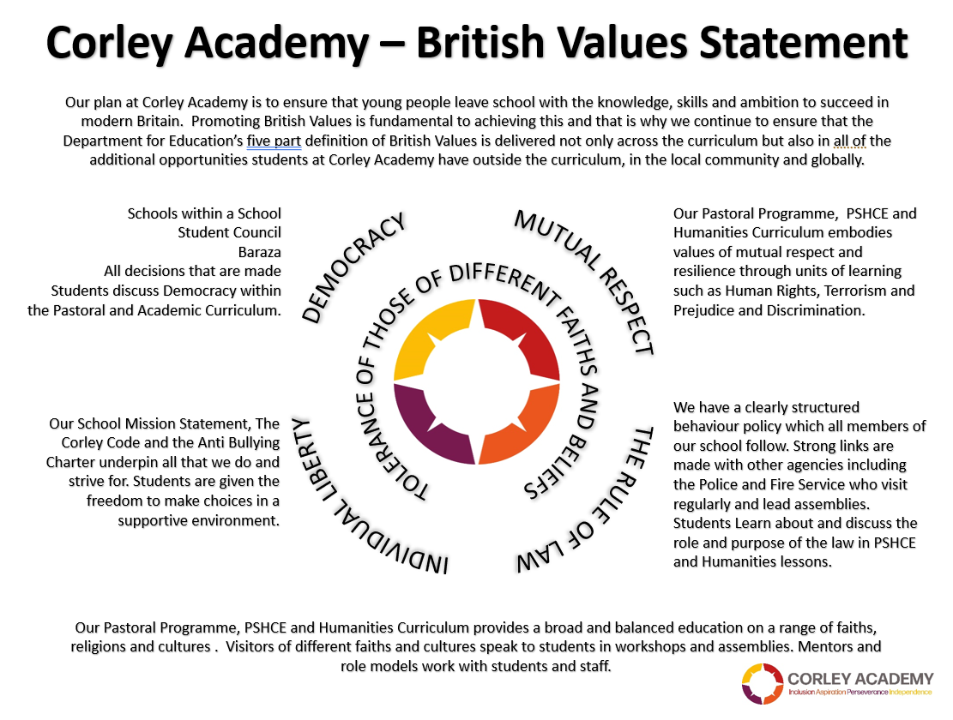



WEEKLY THEME
WEEK BEGINNING
02.06.25
ENVIRONMENT
CHILDRENS RIGHTS
UNRC
KEYS TO SUCCESS
SUMMER 2
Notes:
1

Slide 2



WEEKLY THEME
WEEK BEGINNING
09.06.25
HEALTHY EATING
CHILDRENS RIGHTS
UNRC
KEYS TO SUCCESS
SUMMER 2
Notes:
2

Slide 3




WEEKLY THEME
WEEK BEGINNING
16.06.25
CHILD LABOUR
CHILDRENS RIGHTS
UNRC
KEYS TO SUCCESS
SUMMER 2
Notes:
3

Slide 4




WEEKLY THEME
WEEK BEGINNING
23.06.25
REFUGEES
CHILDRENS RIGHTS
UNRC
KEYS TO SUCCESS
SUMMER 2
Notes:
4

Slide 5






WEEKLY THEME
WEEK BEGINNING
30.06.25
CARE AND ADOPTION
CHILDRENS RIGHTS
UNRC
KEYS TO SUCCESS
SUMMER 2
Notes:
5

Slide 6




WEEKLY THEME
WEEK BEGINNING
07.07.25
SUMMER
CHILDRENS RIGHTS
UNRC
KEYS TO SUCCESS
SUMMER 2
Notes:
6

Slide 7



WEEKLY THEME
WEEK BEGINNING
14.07.25
CELEBRATION ASSEMBLIES
CHILDRENS RIGHTS
UNRC
KEYS TO SUCCESS
SUMMER 2
Notes:
7

