Slide 1




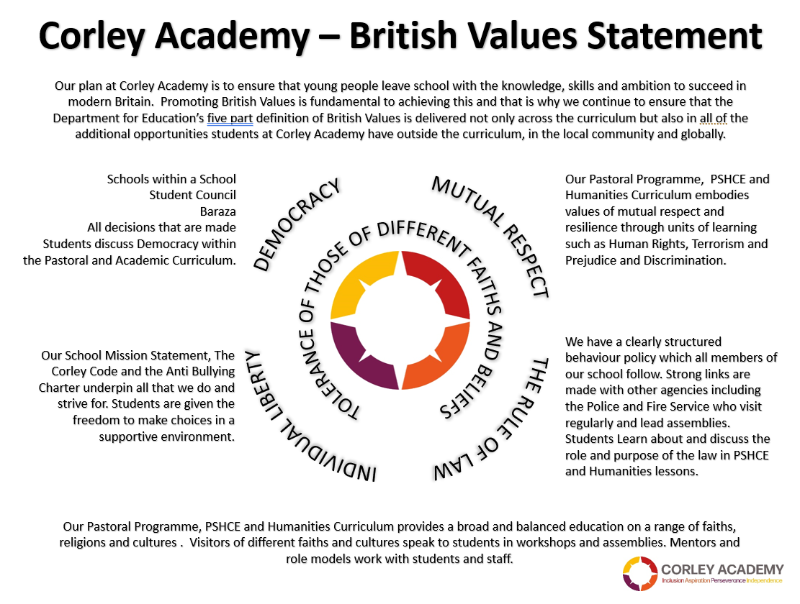



WEEKLY THEME
WEEK BEGINNING
28.04.25
EARTH DAY
CHILDRENS RIGHTS
UNRC
KEYS TO SUCCESS
SUMMER 1
Notes:
1

Slide 2



WEEKLY THEME
WEEK BEGINNING
05.05.25
LEGAL AND ILLEGAL DRUGS
CHILDRENS RIGHTS
UNRC
KEYS TO SUCCESS
SUMMER 1
Notes:
2

Slide 3


WEEKLY THEME
WEEK BEGINNING
12.05.25
MENTAL HEALTH
CHILDRENS RIGHTS
UNRC
KEYS TO SUCCESS
SUMMER 1
Notes:
3

Slide 4



WEEKLY THEME
WEEK BEGINNING
19.05.25
THE RIGHT TO PRIVACY
CHILDRENS RIGHTS
UNRC
KEYS TO SUCCESS
SUMMER 1
Notes:
4

