Slide 1




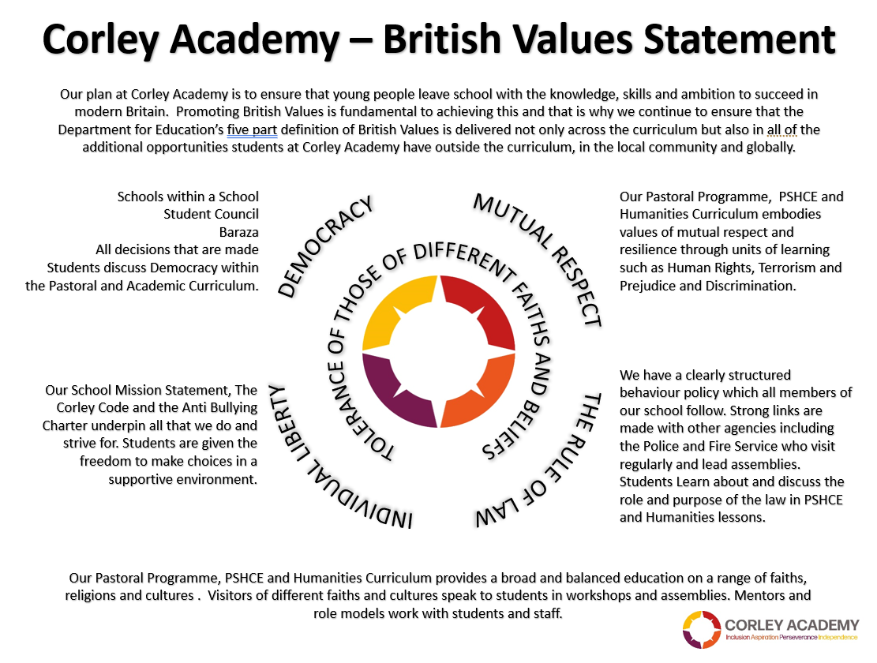



WEEKLY THEME
WEEK BEGINNING
24.02.25
SOCIAL JUSTICE
CHILDRENS RIGHTS
UNRC
KEYS TO SUCCESS
SPRING 2
Notes:
1

Slide 2





WEEKLY THEME
WEEK BEGINNING
03.03.25
WORLD BOOK DAY
CHILDRENS RIGHTS
UNRC
KEYS TO SUCCESS
SPRING 2
Notes:
2

Slide 3



WEEKLY THEME
WEEK BEGINNING
10.03.25
WOMENS DAY
CHILDRENS RIGHTS
UNRC
KEYS TO SUCCESS
SPRING 2
Notes:
3

Slide 4




WEEKLY THEME
WEEK BEGINNING
17.03.25
WORLD WATER DAY
CHILDRENS RIGHTS
UNRC
KEYS TO SUCCESS
SPRING 2
Notes:
4

Slide 5



WEEKLY THEME
WEEK BEGINNING
24.03.25
EID
CHILDRENS RIGHTS
UNRC
KEYS TO SUCCESS
SPRING 2
Notes:
5

Slide 6



WEEKLY THEME
WEEK BEGINNING
31.03.25
AUTISM AWARENESS
CHILDRENS RIGHTS
UNRC
KEYS TO SUCCESS
SPRING 2
Notes:
6

Slide 7


WEEKLY THEME
WEEK BEGINNING
07.04.25
NATIONAL PETS DAY
CHILDRENS RIGHTS
UNRC
KEYS TO SUCCESS
SPRING 2
Notes:
7

