Slide 1




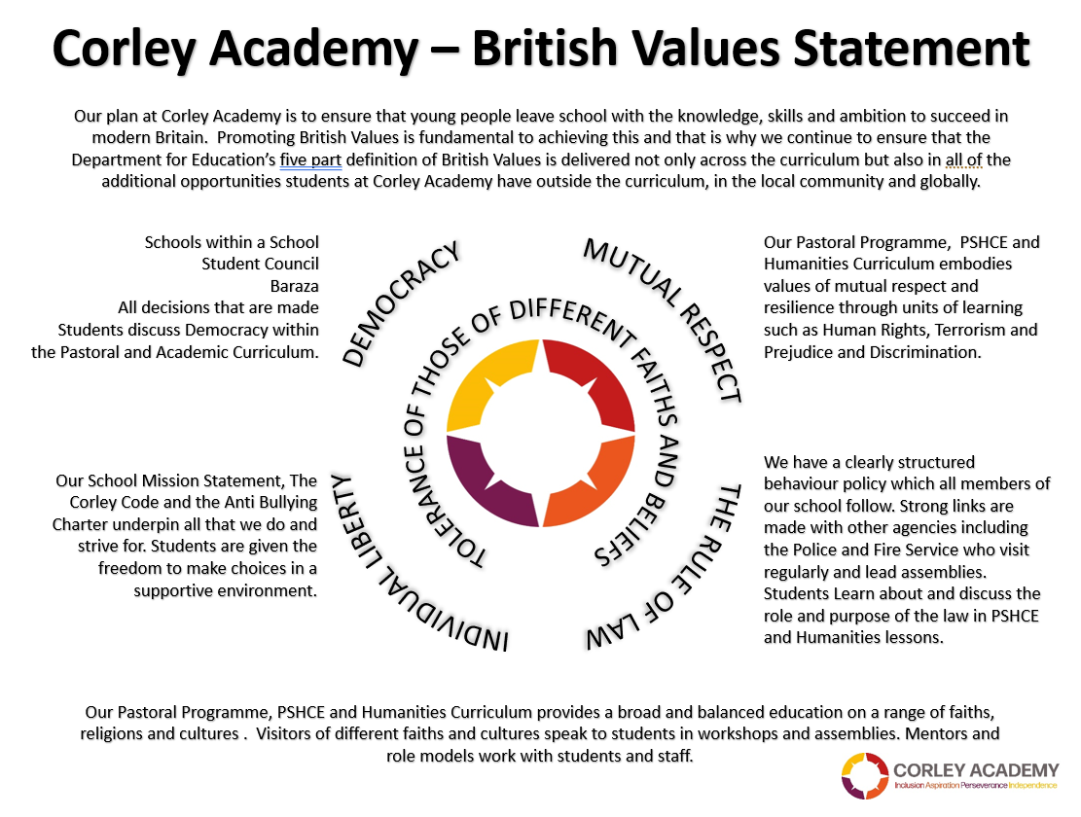



WEEKLY THEME
WEEK BEGINNING
06.01.25
CHILDRENS RIGHTS
UNRC
KEYS TO SUCCESS
SPRING 1
Notes:
1

Slide 2




WEEKLY THEME
WEEK BEGINNING
13.01.25
LAW AND JUSTICE
CHILDRENS RIGHTS
UNRC
KEYS TO SUCCESS
SPRING 1
Notes:
2

Slide 3




WEEKLY THEME
WEEK BEGINNING
20.01.25
EDUCATION
CHILDRENS RIGHTS
UNRC
KEYS TO SUCCESS
SPRING 1
Notes:
3

Slide 4






WEEKLY THEME
WEEK BEGINNING
27.01.25
Holocaust
CHILDRENS RIGHTS
UNRC
KEYS TO SUCCESS
SPRING 1
Notes:
4

Slide 5


WEEKLY THEME
WEEK BEGINNING
03.02.25
LGBT+ History Month
CHILDRENS RIGHTS
UNRC
KEYS TO SUCCESS
SPRING 1
Notes:
5

Slide 6



WEEKLY THEME
WEEK BEGINNING
10.02.25
SAFER INTERNET DAY
CHILDRENS RIGHTS
UNRC
KEYS TO SUCCESS
SPRING 1
Notes:
6

