Slide 1



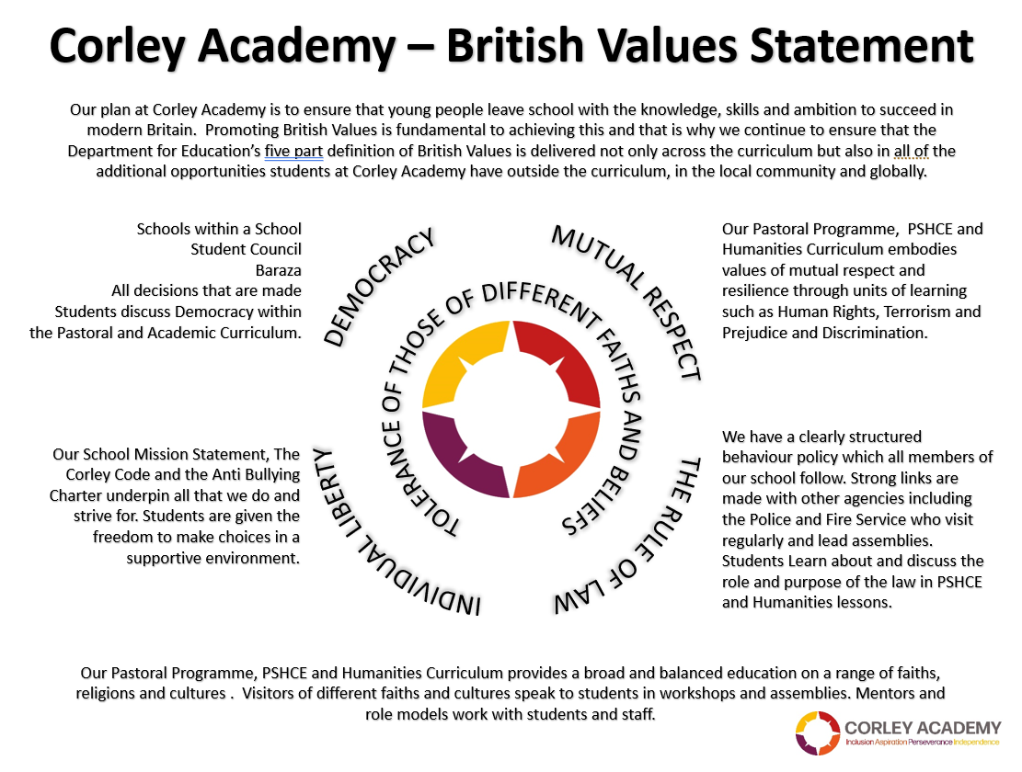



WEEKLY THEME
WEEK BEGINNING
04.11.24
REMEMBRANCE
CHILDRENS RIGHTS
UNRC
KEYS TO SUCCESS
AUTUMN 2
Notes:
1

Slide 2





WEEKLY THEME
WEEK BEGINNING
11.11.24
ANTI BULLYING WEEK
CHILDRENS RIGHTS
UNRC
KEYS TO SUCCESS
AUTUMN 2
Notes:
2

Slide 3



WEEKLY THEME
WEEK BEGINNING
18.11.24
WORLD CHILDREN’S
DAY
CHILDRENS RIGHTS
UNRC
KEYS TO SUCCESS
AUTUMN 2
Notes:
3

Slide 4



WEEKLY THEME
WEEK BEGINNING
25.11.24
VIEWS OF THE CHILD
CHILDRENS RIGHTS
UNRC
KEYS TO SUCCESS
AUTUMN 2
Notes:
4

Slide 5



WEEKLY THEME
WEEK BEGINNING
02.12.24
DISABILITIES
CHILDRENS RIGHTS
UNRC
KEYS TO SUCCESS
AUTUMN 2
Notes:
5

Slide 6




WEEKLY THEME
WEEK BEGINNING
09.12.24
HUMAN RIGHTS
CHILDRENS RIGHTS
UNRC
KEYS TO SUCCESS
AUTUMN 2
Notes:
6

Slide 7

WEEKLY THEME
WEEK BEGINNING
16.12.24
HUMAN SOLIDARITY
CHILDRENS RIGHTS
UNRC
KEYS TO SUCCESS
AUTUMN 2
Notes:
7

