Slide 1




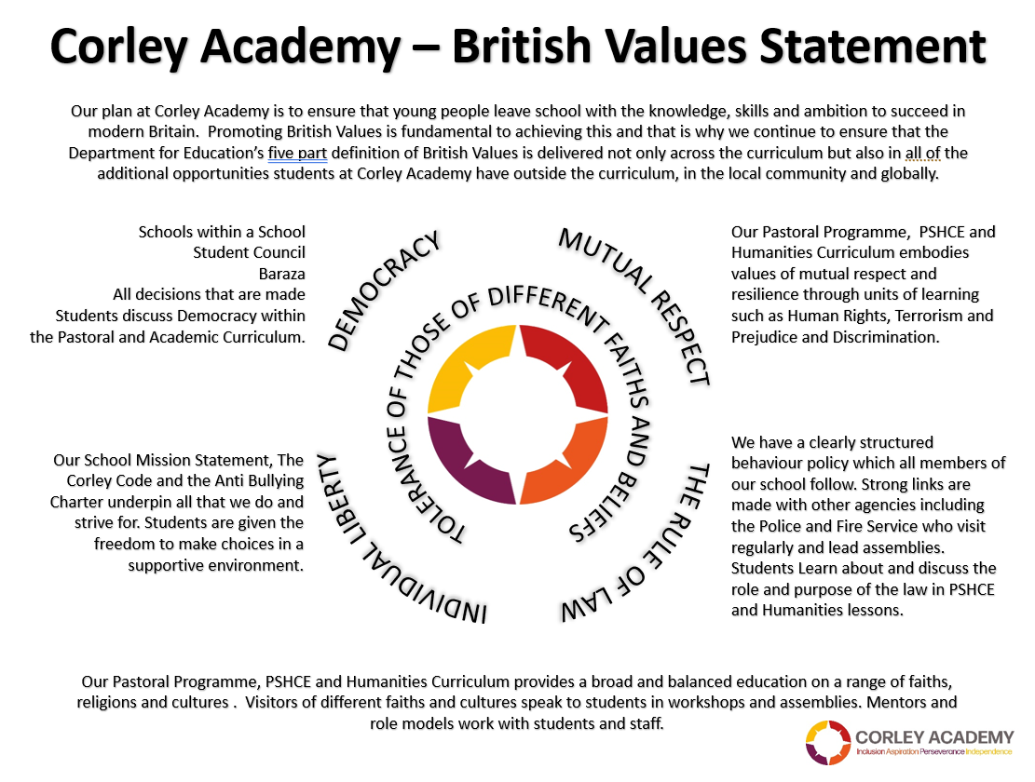



WEEKLY THEME
WEEK BEGINNING
02.09.24
CHILDRENS RIGHTS
UNRC
KEYS TO SUCCESS
AUTUMN 1
Notes:
1

Slide 2




WEEKLY THEME
WEEK BEGINNING
09.09.24
LITERACY
CHILDRENS RIGHTS
UNRC
KEYS TO SUCCESS
AUTUMN 1
Notes:
2

Slide 3




WEEKLY THEME
WEEK BEGINNING
16.09.24
DEMOCRACY
CHILDRENS RIGHTS
UNRC
KEYS TO SUCCESS
AUTUMN 1
Notes:
3

Slide 4


WEEKLY THEME
WEEK BEGINNING
23.09.24
PEACE
CHILDRENS RIGHTS
UNRC
KEYS TO SUCCESS
AUTUMN 1
Notes:
4

Slide 5




WEEKLY THEME
WEEK BEGINNING
30.09.24
BLACK HISTORY
CHILDRENS RIGHTS
UNRC
KEYS TO SUCCESS
AUTUMN 1
Notes:
5

Slide 6




WEEKLY THEME
WEEK BEGINNING
07.10.24
MENTAL HEALTH
CHILDRENS RIGHTS
UNRC
KEYS TO SUCCESS
AUTUMN 1
Notes:
6

Slide 7


WEEKLY THEME
WEEK BEGINNING
14.10.24
WORLD FOOD
CHILDRENS RIGHTS
UNRC
KEYS TO SUCCESS
AUTUMN 1
Notes:
7

Slide 8


WEEKLY THEME
WEEK BEGINNING
21.10.24
UNITED NATIONS
CHILDRENS RIGHTS
UNRC
KEYS TO SUCCESS
AUTUMN 1
Notes:
8

