Slide 1

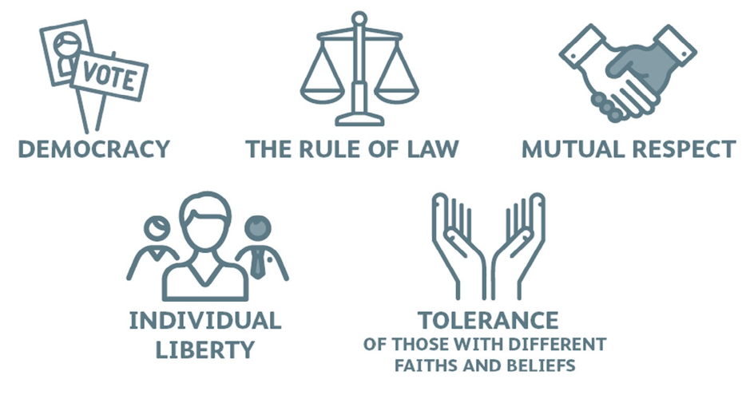
British Values

Slide 2
British Values
During the next half term we will be talking about British Values. These are the 5 core ideas that are most important to British people. We will focus on one each week. Today we will be looking at individual liberty.

Slide 3
What is individual liberty?
Another word for individual liberty is freedom. The freedom to make our own choices about ourselves. This could be how we look, what we like, who we associate with, what we wear or what we eat.
We also have life choices such as what job we do or who we vote for. Nobody else can make these decisions for us.

Slide 4

Does individual liberty mean I can do what I want?
It depends. If you make choices which impact other people then this could show a lack of respect to others or even break the law. This would then disregard the other British Values we have discussed before and could impact other people’s human rights.
Look at the following examples and decide whether they are impacting on the human rights of others.

Slide 5
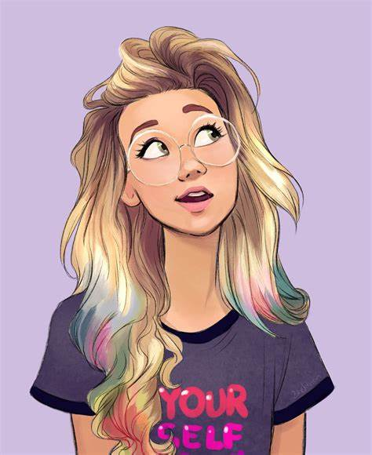
Does individual liberty mean I can do what I want?
Katya has set up a book club. She has said that the only people allowed to join are girls with blonde hair.

Slide 6
Does individual liberty mean I can do what I want?
Thamid is telling the class about a festival his family recently celebrated. Tia listens with interest.

Slide 7
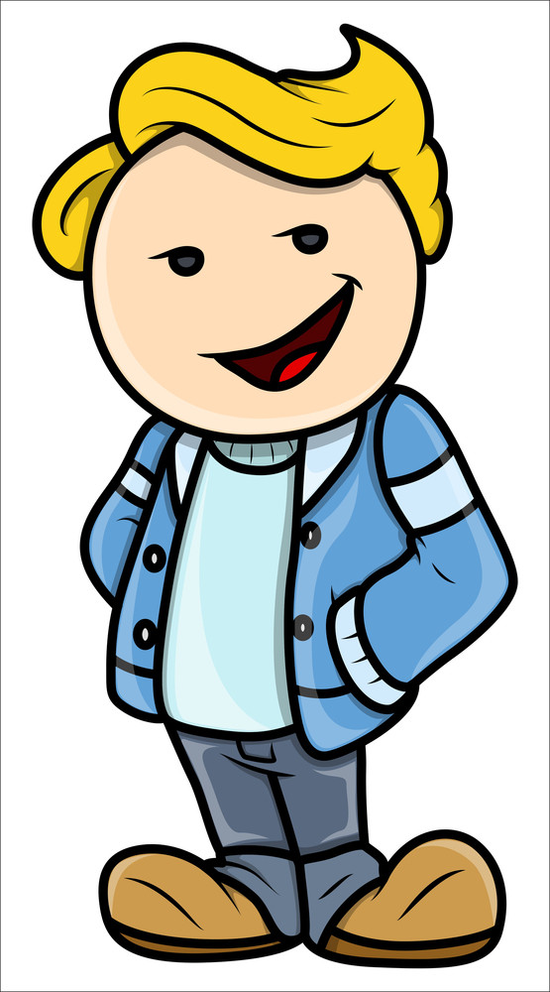
Does individual liberty mean I can do what I want?
Julio has written a private letter to a friend. Another child in his class takes it and reads it out to his group of friends.

Slide 8
Does individual liberty mean I can do what I want?
Lucia and Jose are exploring what clubs are available at the local leisure centre. They read the information leaflet carefully and sign up for ones they are interested in.

Slide 9
Our own individual liberty
Enjoying our own individual liberty is about believing that we have the freedom to express ourselves and live our lives in a way we choose. It is important that this is done with respect for the individual liberty and human rights of others.
Think for a moment about what this might look like.
We can make choices about what activities we enjoy.
We can share our views respectfully with others.
We can explore topics that interest us to learn more.
We can choose to keep certain things private.

Slide 10
How can we promote individual liberty?
We have looked at what individual liberty is and what this can mean for society around us.
Now think quietly about these questions:
How can we promote individual liberty in our classroom?
How can we promote individual liberty in our school?
How can we promote individual liberty in our local community?

Slide 11


