Slide 1

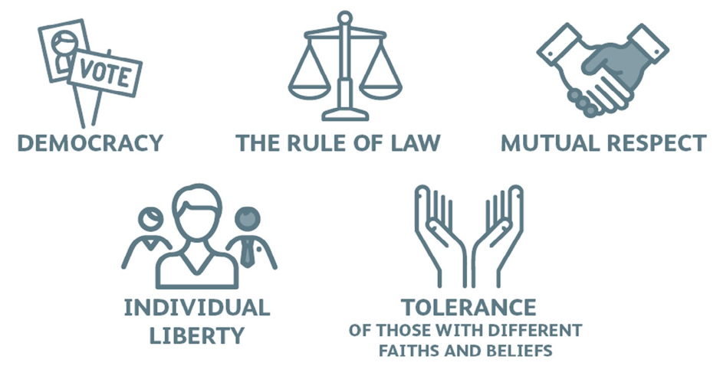
British Values

Slide 2
British Values
During the next half term we will be talking about British Values. These are the 5 core ideas that are most important to British people. We will focus on one each week. Today we will be looking at democracy.

Slide 3
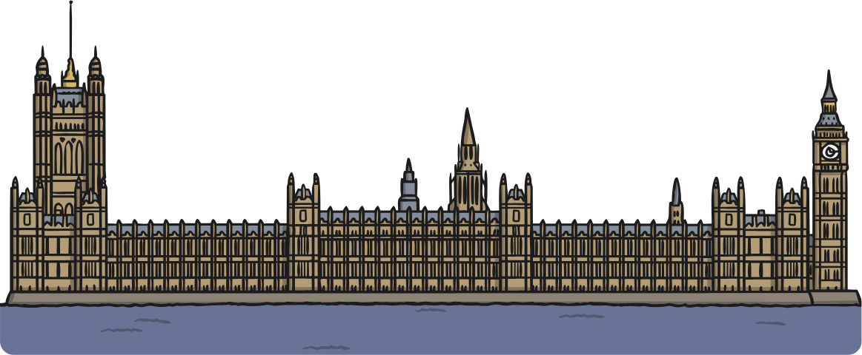
What is democracy?
Democracy is the way our political system is run. It means ‘rule by the people’.
It comes from the Greek words dêmos, which means people, and krátos which
means rule or strength.

Slide 4
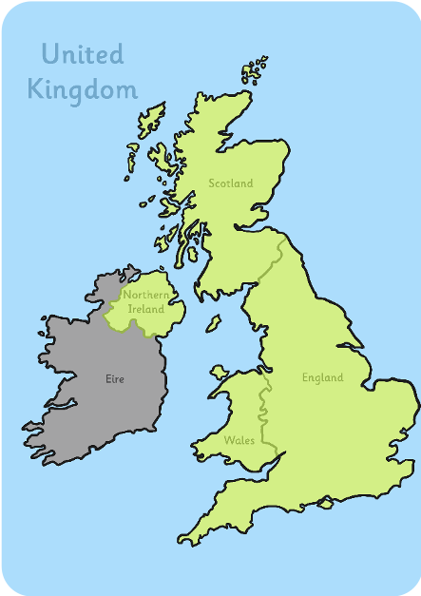
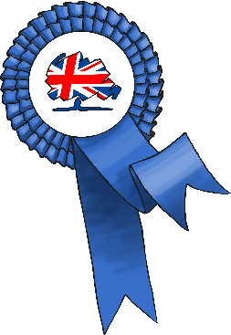
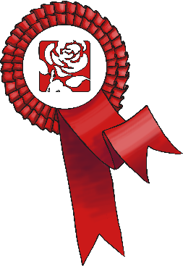
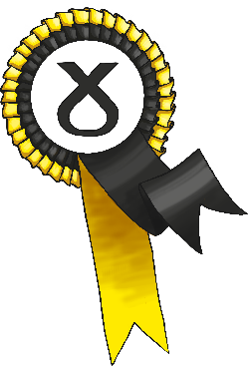
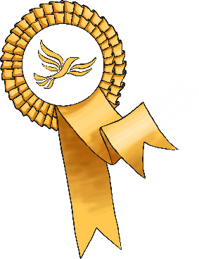
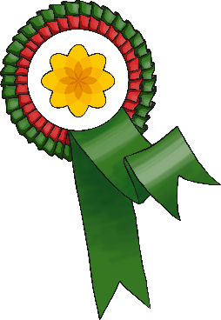

What does democracy mean?
In the United Kingdom, we hold an election to choose someone to represent us.
Most candidates who ’stand’ for election belong to a political party – a group of people who share similar beliefs.
Together, people who belong to the party agree on changes they will make if they are elected. These are called policies.
The leaders of the political parties share their main policies with members of
the public.

Slide 5
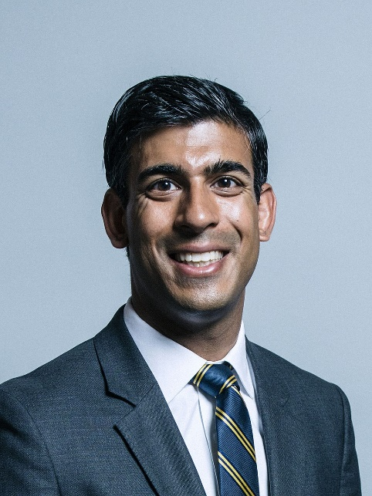
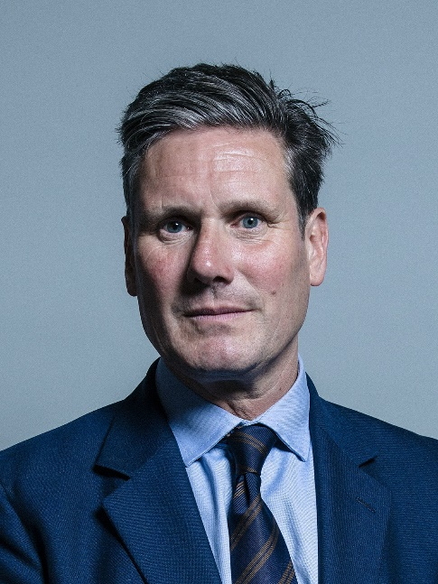
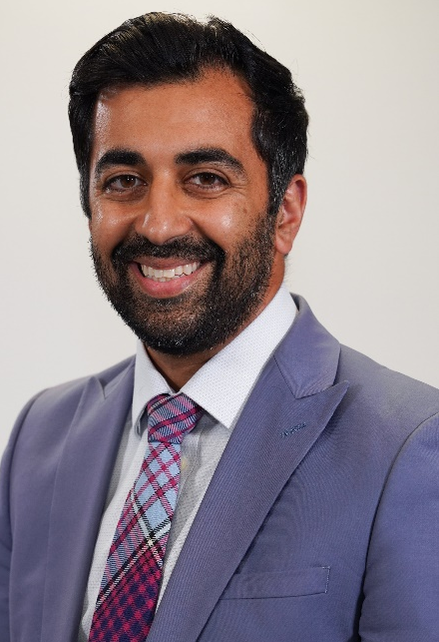
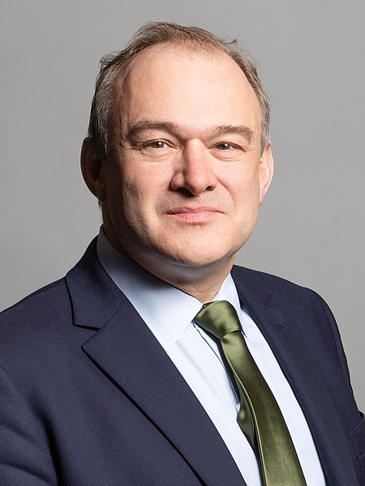

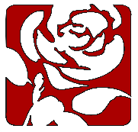


The main political parties in the UK
Rishi Sunak
Conservatives
Sir Keir Starmer
Labour
Humza Yousaf SNP
Ed Davey
Liberal Democrats

Slide 6
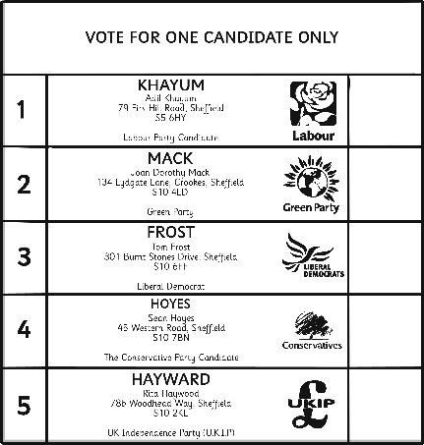
How do people vote?
Every citizen should listen to the policies of the different parties and candidates. Then they should decide on who to vote for.
People must be 18 or over to take part in an election.
Each person votes for the candidate of his or her choice. They do this by putting a ‘X’ cross beside the person’s name on the ballot paper.

Slide 7
How is a political party elected?
The UK is split up into a total of 650 constituencies (areas). Each of these has a Member of Parliament (MP) representing them. Each MP has a seat in the House of Commons. To win a general election (to decide which political party is in charge and who the prime minister is) you need to win half of all the constituencies plus one (326). The leader of the political party who reaches this number of seats becomes the prime minister.

Slide 8
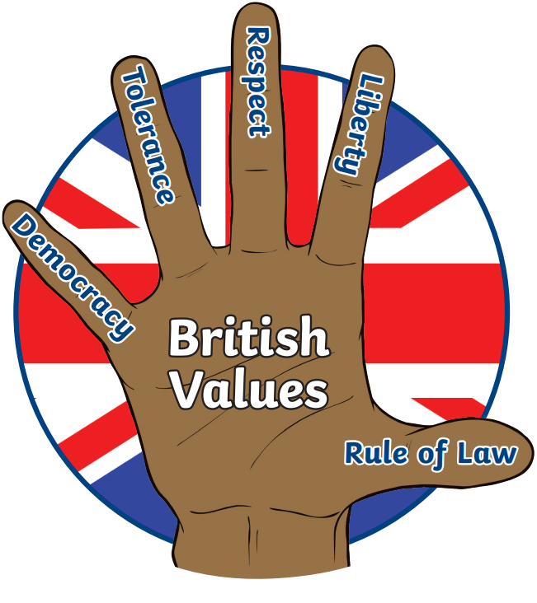
Have a look at the timeline to see how democracy has developed in the UK.

