Slide 1

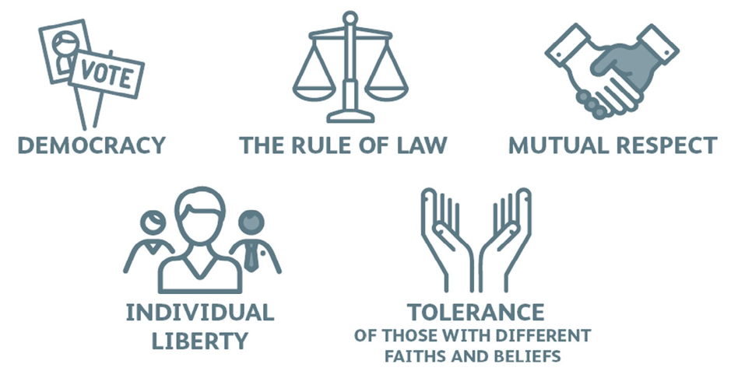
British Values

Slide 2
British Values
During the next half term we will be talking about British Values. These are the 5 core ideas that are most important to British people. We will focus on one each week. Today we will be looking at respect and tolerance of those with different faiths and beliefs.

Slide 3
Respect and tolerance of those with different faiths and beliefs
Respect and tolerance are words that describe how we treat other people.
If we respect someone, we treat them in a way that shows we value them and think they are important.
If we are tolerant of something, it shows we accept the differences between people.

Slide 4
Tolerance of those with different faiths and beliefs
Respect and tolerance are ways of treating other people that show we understand and value the differences between us.
This is the understanding that we are all different and have different beliefs and values. It is accepting and respecting this, and involves no one person or group of people thinking they are more important, more deserving or better than anyone else.
Respecting others and being tolerant of people around us is linked to people’s human rights. We all have the right to live healthy, safe and happy lives, where our different values are accepted and respected.

Slide 5
Tolerance of those with different faiths and beliefs
There are many different faiths and beliefs in Britain, practiced by many different people. They may be very strict and follow their religion closely, or they may be quite relaxed and just see it more like a set of guidelines to live by.
Some may be part of a religion but not actually believe it to be true.
Some people do not follow any religion or believe in any gods.

Slide 6
Tolerance of those with different faiths and beliefs
These are the most followed religions in Britian:
Christian 42.6%
No religion 37.2%
Muslim 6.5%
Hindu 1.7%
Sikh 0.9%
Other religion 0.6%
Buddhist 0.5%
Jewish 0.5%
Religion not stated 6%

Slide 7
Tolerance of those with different faiths and beliefs
Each of these religions have contradictory (opposing) ideas about the universe, how it came to be and our place within it. They will not all agree on many things. This is why it is important we can respect those who have differing opinions to our own and show a tolerance of ideas which we may consider different, unusual or even wrong.

Slide 8

On your sheet, explain how your show tolerance and respect to others, or how you could show tolerance and respect to those with different beliefs to your own.

