Slide 1

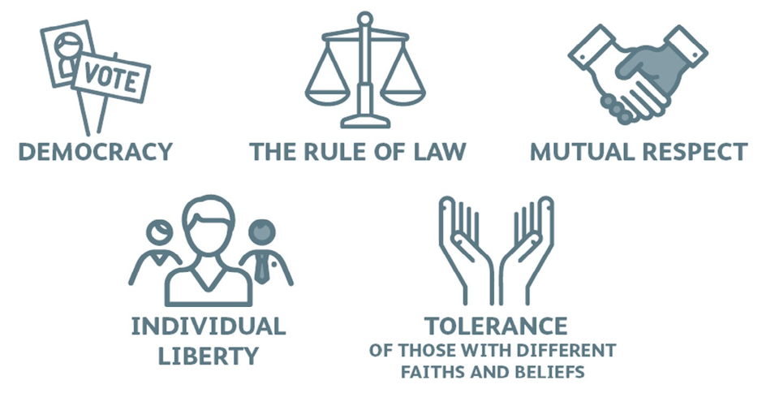
British Values

Slide 2
British Values
During the next half term we will be talking about British Values. These are the 5 core ideas that are most important to British people. We will focus on one each week. Today we will be looking at The Rule of Law.

Slide 3
Why does Britain have a legal system?
Think of as many reasons as you can why most societies have laws and a legal system.
Here are just a few:
To prevent anti-social and unacceptable behaviour.
To regulate commercial and business transactions.
To identify who should rightfully own property.
To regulate family and personal relationships.
To provide means for citizens to resolve disputes with other citizens.

Slide 4
Civil Law and Criminal Law
There are two types of law:
Civil law
Criminal law
The courts of England and Wales are headed by the Senior Courts of England and Wales:
The High Court of Justice (for civil cases)
The Crown Court (for criminal cases).
The Supreme Court is the highest court in the land for both criminal and civil appeal cases.

Slide 5
Civil Law
Civil law is concerned with the rights and duties of citizens in dealings with other citizens.
Civil law covers activities such as:
Lending and borrowing money
Entering into contracts
Disputes with neighbours
Getting married
Inheritances and wills

Slide 6
Criminal Law
Criminal offences are regarded as offences against society. It includes the punishment of people who break these laws.
It deals with matters such as:
Crimes against people:
E.g. murder, assault
Property crimes:
E.g. theft, burglary, fraud and vandalism

Slide 7
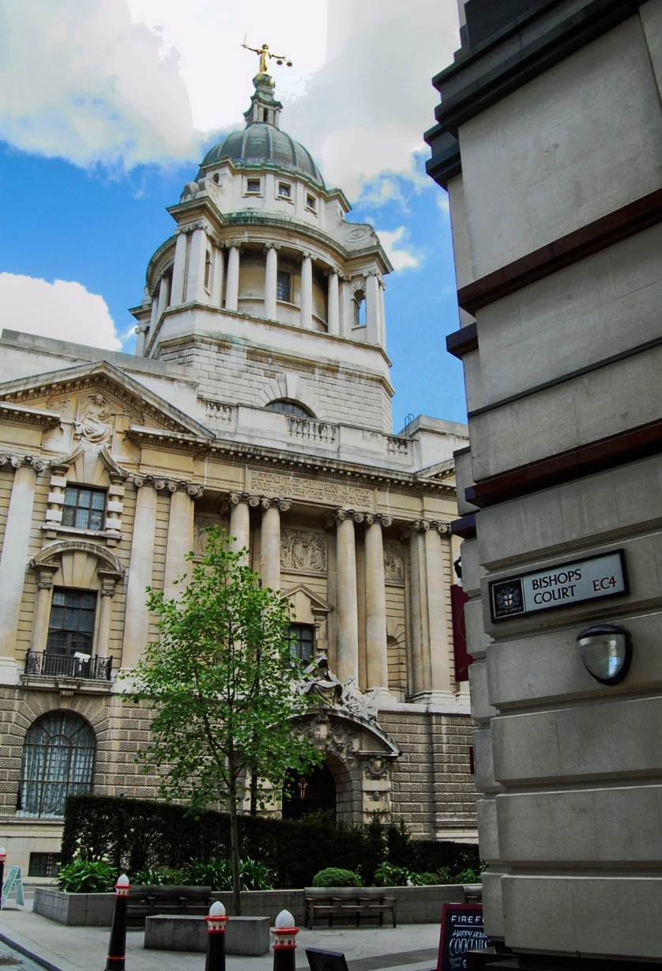
The Old Bailey
The Central Criminal Court of England and Wales, commonly known as the Old Bailey from the street on which it stands, is a court in London, and one of a number of buildings housing the Crown Court.

Slide 8
Compensation or Punishment?
In civil law, the courts award compensation when someone can prove the other party is in the wrong.
In criminal courts, the aim is to punish wrongdoers and impose a sentence which prevents them from reoffending.
Compensation
This refers to the act of providing a person with money or other things of value in order to provide for the costs of injuries that they have incurred.
Sentence
This can generally involve imprisonment, a fine and/or other punishments against a defendant convicted of a crime.

Slide 9
Your Turn
What laws would you change or what laws would you create?
Try and think of laws you would change or new laws you would introduce. You have to give reasons for your answers.

